Slide 1
Centralized Telemetry
Care Model Subgroup Current State Analysis Summary

Slide 2
Overview
Literature Review
Interviews
APeX reports needed to assess current patient on CPO
Next Steps
Appendix

Slide 3
I. Literature Search

Slide 4
Literature Review Findings: Search strategies
Search strategy 1:
Consultation with medical librarian Peggy Tahir.
Date searched: 8/30/2022
Limits: Embase limit to articles/articles in press
PubMed:
(("Oximetry"[Mesh] AND continuous) OR “continuous pulse oximetry”) AND (guideline* OR “care model*” OR consensus OR recommend* OR “best practice*”)
References = 1,547
Web of Science:
(“continuous pulse oximetry” OR (continuous AND “pulse oximetry”))
References = 831
Embase:
'continuous pulse oximetry' OR (('pulse oximetry'/exp OR 'pulse oximetry') AND continuous)
References = 1,362
Total references from all databases = 3,740
Total references after duplicates removed = 2,974*
Results scanned and searched for key phrases including “inpatient”, “continuous pulse oximetry”, “radomiz(s)ed clinical trial”
Search strategy 2
PubMed:
("Oximetry"[Mesh] AND continuous) OR “continuous pulse oximetry”) AND (guideline* OR “care model*” OR consensus OR recommend* OR “best practice*”)
References = 239
All abstracts and some full text reviewed
112 articles deemed relevant across both searches

Slide 5
Literature Review Findings: themes identified
Importance in those with risk for OSA
On supplemental oxygen or non-invasive ventilation
Pediatrics: Over-use in bronchiolitis, criteria in asthma, role in severe pneumonia
Acute post-stroke
Patients admitted for EEG
Specific meds with strong sedative properties: brexanolone
Intermittent vs continuous
Delphi process in pediatrics for intermittent vs continuous
Intermittent vs continuous, cost-effectiveness
Spot checks, awaken, hyperventilate, no arousal effect in another study
Poor relationship between CPO and manually charted spot data: Taenzer et al.
Postoperative hypoxemia common by CPO in multiple studies
Post-op CPO improves outcomes: Taenzer et al. used the Massimo SafetyNet monitoring system which was also then used in med-surg units by Cipriano et al. These groups also studied impact on ICU admission, as did Ochroch et al.
CPO catches events bariatric surgery and long bone fractures
CT surgery trials: no effect on post CT surg patients in ICU or mortality or cost, another study showed a benefit on ICU admissions
IV Opiates
Post-op, PRODIGY vs Watkinson
Opiates including cost-effectiveness (PRODIGY)
Willens: Monitoring adults with intermittent pulse oximetry while using intravenous patient-controlled analgesia (IV PCA) was 58%.
Mcgrath et al.: impact of continuous monitoring on respiratory arrest
Patterns from CPO data before inpatient PEA arrest: Mcgrath et al.
Effects of skin pigmentation
Educational projects, surveys of MD and RN knowledge
Alarm fatigue
Helgeson et al. Mayo Florida: Model on when and how to discontinue CPO
Gaps in literature:
What level of care to match with CPO based on situation
Who receives alarms, and how alarms are escalated

Slide 6
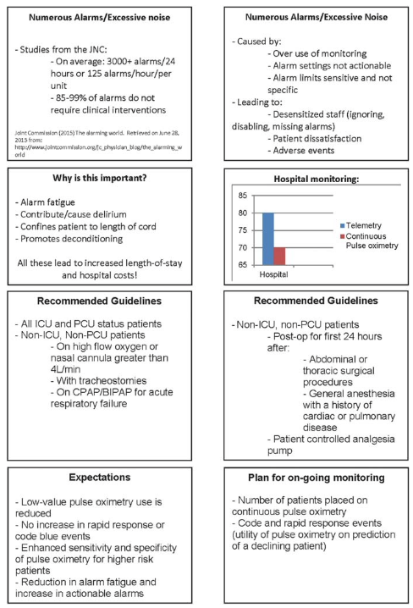
Scott Helgeson et al. 2018. Mayo Clinic
6
Discontinuation policy for continuous pulse oximetry for RTs.

Slide 7
II. Interviews

Slide 8
Interviews
MDs: 12 attendings, 3 trainees, and 1 OSH attending
11 Frontline staff:
Hospital Medicine | Kristin Kipps
Hospital Medicine | Nader Najafi
Cardiology | Mandar Aras
Surgery | Ian Soriano
Anesthesia | Matthias Braehler
Pain Service | Matthias Behrends
Pediatrics | Deborah Franzon
Pulmonary/CC | Lekshmi Santosh
Gastroenterology | Sun Dai
Orthopedics | Bobby Tay
Neurology | Sarah LaHue
Cardiothoracic surgery | Amy Fiedler
Fellow | Hope Caughron
Medicine Resident (PGY3) | Sven Walderich
Surgical Resident | Alexis Colley
Mayo Clinic | Dr. Helgelson
Bedside Nurse | Daniel Roseland
Bedside Nurse | Olga Sukshenko
PCA | Ejigayehu (Eji) Bekele
Monitor Tech | Zarah Mendoza
Tele/monitor RN | Luba Del Puerto
Ortho PA | Patricia Rodgers
Neurospine NP | Michael Heinback
Neurospine NP | Julie Cassata
Advanced Practice manager | Melissa Lee
Rapid Response RN | Martha McClure
Director of TCU at Parn, centralized telemetry | Elizabeth Sin
Director of TCU and ped med/surg at MB | Denise Shaw
Notes:
15 ucsf providers, 1 mayo clinic
11 frontline staff

Slide 9
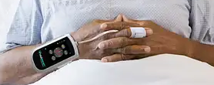
Interview Themes/Recommendations
Themes/Recommendations:
specific conditions such as post abdominal surgery with certain risks
EHR order support like at SFGH, renewal of order requirements
Current orders “make it easy to check off and order”
Some order sets have CPO prechecked
RN RT driven discontinuation workflow empowers them such as with Foley dc
other modalities to consider (capnography, video)
skin tone
learn from tele care model, review alarm criteria and suggest both absolute and delta.
Decentralize?
Other forms of wireless monitoring
Notes:
Can we use the stop bang data to help drive who gets put on CPO?

Slide 10
Interviews – Physicians Summary
MD Name | Service | Apex ordering/discontinuing guidance | CPO as a surrogate for higher level of care? | CPO for desat? | Is CPO overordered? | Is CPO left longer than needed? | Communication as an issue? | Nurse as a guidance of when patient should be on/off CPO?
Kristin Kipps | Hospital Medicine | x | x | x | x | x |  | x
Nader Najafi | Hospital Medicine | x | x | x | x | x
Mandar Aras | Cardiology | x |  | x |  | x |  | x
Ian Soriano | Surgery | x | x | x |  |  |  | x
Matthias Braehler | Anesthesia |  |  | x
Matthias Behrends | Pain Service |  |  | x
Deborah Franzon | Pediatrics
Hope Caughron | Fellow | x | x | x | x | x
Sven Walderich | Senior Resident | x |  | x | x | x |  | x
Alexis Colley | Surgical Resident | x | x | x | x | x |  | x
Lekshmi Santosh | Pulmonary/CC |  | x | x |  | x
Sun Dai | Gastroenterology |  |  | x | x
Bobby Tay | Orthopedics |  | x | x | x | x
Sarah LaHue | Neurology | x |  | x | x | x
Amy Fiedler | Cardiothoracic surgery |  | no | x | x | x

Slide 11
Interviews – Physicians Summary
100% use CPO to monitor for desaturation
50% use CPO as a surrogate for a higher level of care
64% agreed CPO is overordered
>70% felt CPO is not discontinued appropriately and left longer than needed
>50% favor developing an Apex order set to guide ordering and discontinuation of CPO
36% refer to nursing as guidance of when to discontinue CPO
Notes:
1) current state themes (both clinicians and staff)
How CPO is ordered
CPO ordered to monitor desaturation in patients at risk for it: we could include a list of the indications people mentioned: opioids, sleep apnea, pulmonary hypertension therapy, pediatric patients, etc
CPO ordered as a surrogate for higher level of care
CPO ordered because it is part of admission orders
CPO ordered prompted by nursing request
CPO overordered
How CPO is discontinued
CPO left longer than needed
CPO discontinued prompted by nursing request
CPO ordered until discharge: I think many people mentioned this. I remember Lekshmi, Mandar, Deborah, Amy.
CPO discontinued for parent's request: I think only Deborah mentioned this. Not sure if someone else mentioned discontinuation for patient's request
How is CPO managed
clinician never or almost never review CPO waveform with monitoring tech
Nurse page for desaturation prompts 1st call clinician to bedside : I remember Mandar, Lekshmi, Deborah, Amy mentioned this
Variable amount of troubleshooting CPO at bedside: done by nurses in 6 and 10 before they page clinician. I got the impression that when those units call there is mostly always a real issue, because they are very experienced. I think there was more troubleshoting by the clinician when called by other units, but I am not certain. what do you think?
Signal influenced by skin tone
Signal influenced by location of probe

Slide 12
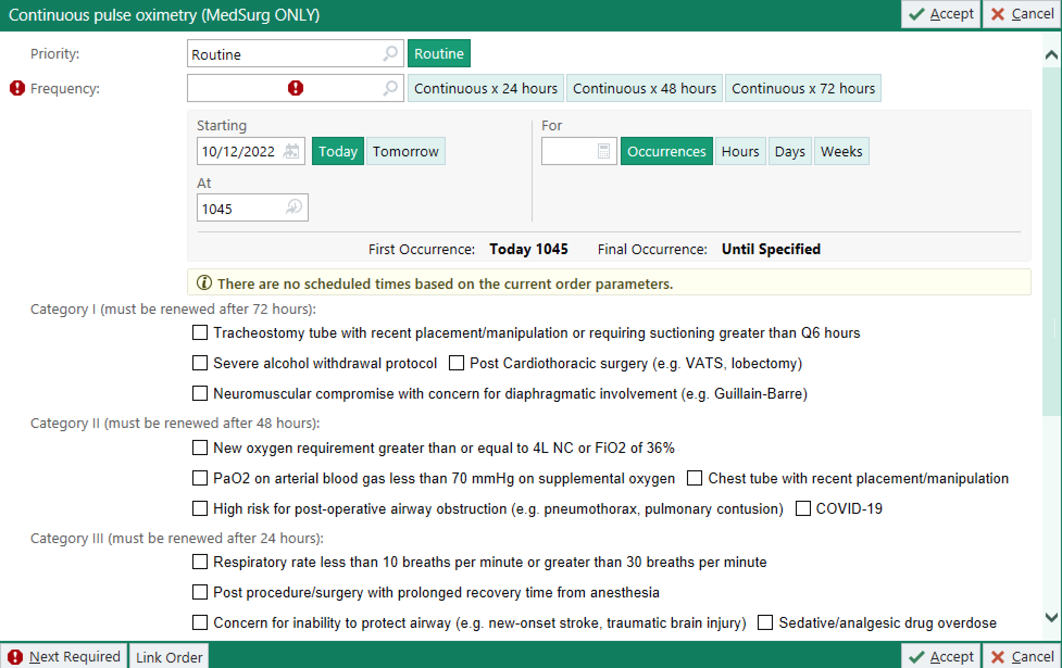
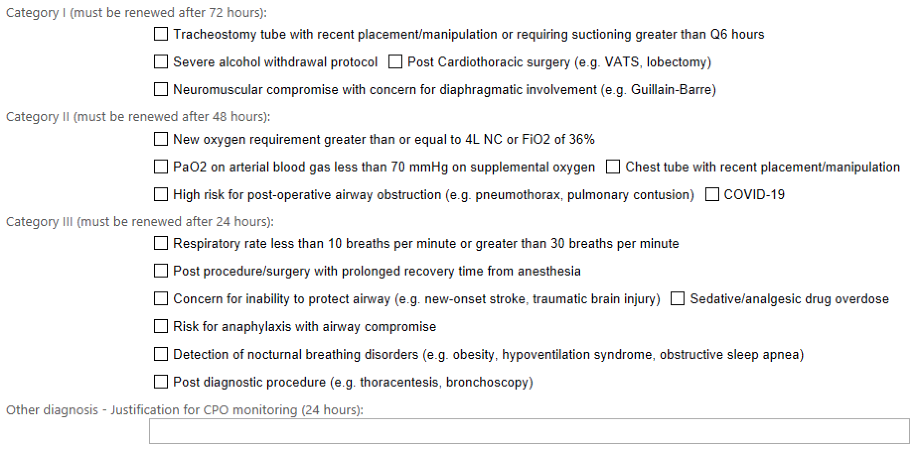
Interview recommendations: ZSFGH Order Sets

Slide 13
Interviews – Frontline staff
The burden of alarms is unsafe, there is alarm fatigue.
Guidance for providers on when to order and discontinue CPO is needed.
CPO is used by providers as a surrogate for “someone is watching the patient”.
The level of care (floor, TCU, ICU) depends on how frequent the patient needs an RN assessment/care, which is not replaced by CPO.
Monitor tech input: “we are not seeing the patients, just the numbers”. Communication with the bedside RN is crucial. CPO monitoring should be decentralized.
RN input: CPO is tenuous, dynamic, the time gap in communication causes inefficiencies. CPO should be decentralized.
Formal training for RNs and PCAs on troubleshooting CPO would be beneficial.
Notes:
A bad pleth wave form can be seen in a patient with true desaturation. Desaturation on a bad pleth form still needs investigation.
CPO ordered for “fear that something bad will happen” and with “a mindset of convenience” (like having a central line for easier blood draws).

Slide 14
Interviews – ways CPO could be improved
Equipment
Better equipment (cables)
Training on CPO placement and troubleshooting
CPO ordering
Apex order set as a guide
Guidelines and education of when CPO should be ordered and discontinued
NDP for discontinuation
Alarm fatigue
Less alarms for bedside staff and monitor techs
Less alarms in patient room without compromising patient safety
Other modes of monitoring suggested
Capnography
Video monitoring
Wireless monitoring
Other
Have other probes (forehead) easily available
Better documentation of probe placement for best saturation
Better way to filter out false positives
Protocol for alarm escalation and resolution
Decentralize CPO
Notes:
guidance on indications for ordering it:
guidance on indications for discontinuation:
Create Apex order sets with clinical decision making guidance
Create a reference document where the guidance in Apex can be found
Nursing-driven protocol for discontinuation of CPO
Decentralizing CPO : (only if that was mentioned)
Education for nursing on probe placement and troubleshooting
Education for clinicians on indications for ordering and discontinuation

Slide 15
Interviews – which patients need CPO?
Which patients need CPO?
Post-operative, recovering from sedation
On opioids (wide range, from PO to PCA), at risk for decreased opioid clearance (older age, renal failure)
With known or suspected OSA, central sleep apnea, obesity hypoventilation syndrome
With an acute respiratory problem (pneumonia, pulmonary embolism, decompensated heart failure)
Undergoing titration of medications that can cause desaturation (e.g. pulmonary hypertension therapies)
Airway problems (airway obstruction)
At risk for aspiration (limited ability to handle secretions, acute post-stroke)
At risk for rapid decompensation (HFNC, tracheostomy)
With a worsening trajectory (new or increasing oxygen needs)
When can CPO be discontinued?
After a period (24-48-72 hr) of stability (no desaturation)
Not until discharge in patients at risk for rapid decompensation
Not until discharge in patients with nocturnal desaturation from known/suspected OSA
Altered mental status/confusion: some advocate CPO, others removal of devices that can worsen delirium or compromise mobility

Slide 16
III. APeX Reports

Slide 17
APeX Reports (new clarity report request)
Clarity Report Objectives:
Know at any given time, how many patients are on CPO, specifically from which service, unit with relationship to hospital discharge to determine if a patient is being monitored appropriately.
As the number of patients on CPO have increased, we need to determine the magnitude of the increase and whether there is appropriate CPO capacity on each unit as per the designated license.
These data points will also assist with understanding the current CPO patient to technician ratio, as well as inform pre and post measurements of success for current improvement interventions as recommended by the clinical CPO care model group.
Apex report elements
Provider
Ordering and authorizing
Average daily census (midnight vs. hourly/total CPO hours)
Service line
Department
How many are on CPO on day of DC
How often are patient on CPO at the day of DC
Patient Demographics
Age
Diagnosis
***Medications (PCA, epidural, IV narcotics infusion)

Slide 18
IV. Next Steps

Slide 19
V. Appendix

Slide 20
III. Next Steps (Jan-May)
APeX decision support
Ordersets
BPA alert
Policy
Invite 2-3 providers and 2-3 frontline staff to meetings to direct draft development
Work with larger CPO group on APeX reports
Discuss RCA cases on the pulmonary division MnM for education of faculty and fellows.
Consider changes to practice that improve patient safety where CPO is inadequate: e.g., paper form at bedside indicating patients with risk for central airway obstruction (analogous to current tracheostomy sheets)
Plan for data collection on changes in use of CPO after implementation of EHR changes

Slide 21
Consultant Interview Questions
Questions to understand the current state
What type of patients would you or your specialty colleagues consider that need continuous pulse oximetry?
What are the reasons you or your specialty colleagues would order continuous pulse oximetry?
What actions would you or your specialty colleagues expect being triggered by a continuous pulse oximetry order?
When would you or your specialty colleagues consider discontinuing continuous pulse oximetry?
What type of patients would you or your specialty colleagues consider that do not need continuous pulse oximetry?
Would other strategies achieve the goals of continuous pulse oximetry for patients in your practice?
Are there any society guidelines, consensus, or studies that guide you or your specialty colleagues’ practice regarding continuous pulse oximetry?
In what ways could monitoring with continuous pulse oximetry be improved?
Do you or your specialty colleagues know that you can order continuous pulse oximetry or telemetry in any floor? And that you can order them separately?
When would you or your colleagues consider transferring a patient from the general floor to TCU despite being on CPO or tele?
When would you or your colleagues consider transferring a patient to the ICU from the TCU despite being on CPO or tele?
For what type of CPO alarm would you, the clinician, like to be called to evaluate a patient? A specific threshold of SpO2 or a % change?
What do you do when nursing calls you to let you know your patient is desatting?
Intern/Resident
Intern/resident: what is your escalation process when you are not sure how to manage patient desatting?
How do you escalate when you are uncomfortable?
Share an example of when you had to escalate.

Slide 22
Consultant Interview Questions
Questions for bedside nurse and other staff
When would you or your colleagues call a clinician for a CPO alarm? Any threshold? Some example situations?
How and when was your training for placing CPO on patients?
What is an example of when CPO was not ordered, and you paged a provider to ask for an order?
What do you achieve by getting the patient on CPO?
When do you reach out to providers for discontinue CPO?
When you learn of a desat, what is your first reaction? (sensor, troubleshooting, actual clinical change?)
How much often do you troubleshoot?
How much time to you spend troubleshooting?
How could CPO monitoring could be improved?
Questions for monitoring tech
When would you or your colleagues call the bedside RN for a CPO alarm? Any threshold? Some example situations?
Voalte vs. phone call?
When do you question the appropriateness of the CPO alarm parameters?
When do you call nursing to clarify CPO parameters?
How often does a nurse call you to update/inform you of CPO parameter changes?
What is your current process to validate correct patients are on CPO? Order parameters?
How often does the nurse tell you why the patient is on CPO?
How could CPO monitoring could be improved?

Slide 23
II. Interviews – Front line staff
Monitor tech: “we are not seeing the patients, just the numbers”. Communication with the bedside RN is crucial. CPO should be on each floor, close to the bedside, not centralized.
The monitor tech communicates with the bedside RN if there is a desaturation on the CPO monitor. The monitor tech understands that desaturations happen in a minute
If there is a bad pleth wave the patient can still be desaturating and potentially in trouble (e.g. patient got up).
Monitor tech discusses troubleshooting with bedside RN when there is a bad pleth.
A red alarm triggers a call to the orange phone, a yellow alert triggers a Voalte alert. There is an escalation protocol: bedside RN > buddy RN > charge RN. The CPO tech does not know what the RN acknowledgement means.
About 60% of the desaturations in 10 CVT, 14 L, and surgical floors are real. The rest is troubleshooting.

Slide 24
II. Interviews – Front line staff
Tele RN (works at night): the equipment, having equipment on each unit
She pushes alert to bedside RN with first desaturation. Communicates with bedside RN. Often bedside RN says patient has OSA and only to call if the desaturation is sustained. She suggests the bedside RN to let the team know, so patients with possible OSA are placed on nocturnal oxygen.
She looks at patient’s history to see what devices a patient has (e.g. HFNC, trach). They identify HFNC patients as some that can crash very fast because it takes them long to recover from a desaturation.
Still with not a good pleth, some patients have true desaturation.
Sometimes if you call you cannot get a hold of the nurse (no answer on the phone).
They triage all patients on Tele/CPO and then present it to the doctors (I was not aware of this).
She does not feel comfortable asking team to discontinue CPO because events can happen.
They are short-staffed.
Last year they had issues with the cables (wiring). Half of the CPO patients in certain units don’t work. It is difficulty troubleshooting. They advise the bedside RN to come and grab a new CPO set up.
It is hard for both tele RNs and bedside nurse to meet in person for troubleshooting (they are both busy).
The setup on 10 CVT works better than the setup in other units. The problem is the cable, not the box. Better cables and if all units can keep their own equipment. They do not have to keep walking down to the obs room to get a new cable.

Slide 25
II. Interviews – Front line staff
Bedside RN:
Would call clinician if there is a change in the status of the patient.
Training for placing CPO was when onboarding (starting working in unit) and when equipment changed.
CPO helps catches events we otherwise would not catch. (e.g. investigating apneic events on patients newly on Bipap)
Discontinue CPO when there have been days of consistency, when patient is admitted on home stable oxygen requirements.
Desaturation happens if the cannula fell or the Bipap machine came off. RN goes to check the patient when alarm received.
Per shift, RN spends 30 min troubleshooting CPO.
Improve CPO by creating order sets to help start and discontinue CPO.

Slide 26
II. Interviews – Front line staff
Bedside RN:
Training about CPO placement was a long time ago, when starting to work on 14 Moffit. They got training from the company (Mossimo).
If patient has consistently spot SpO2 <92%, or patient on narcotics, or patient on HFNC, she asks for a CPO order.
Getting information about trends, helps to catch things early and get RR and primary team involved.
Most of their patients on TCU need CPO.
Patients on room air or stable oxygen with no desats on 1-2 shifts, she may ask primary team about discontinuing CPO. May be an oversight not to stop CPO prior to discharge.
She clicks button acknowledge and view. If good pleth and desat she would check on patient.
Troubleshooting has been much better with the new sensors. Now, only spending a few minutes troubleshooting per shift.
Could something be done about artifacts. There are a large number of alerts and some are normal. Figure out how to decrease the amount of alerts, the RN should only get the high alerts.
CPO does not have an indication in the order set (tele has). She would ask the primary team about discontinuing CPO if it does not seem needed.
Good to have forehead probes. You get an ABG and confirm patients are hypoxic.
She compares the room monitor to the CPO box as part of the troubleshooting.
It is difficult to respond to alerts when you are covering a floor nurse. It works better to send the alerts to the charge RN for covering floor nurses.

Slide 27
II. Interviews – Front line staff
PCA
She gets asked (by obs room, secretary, bedside RN) to check on patient’s for CPO alerts. Mostly, to check on a low battery or the probe came off. She needs to make sure the probe is on and reading right.
She does not receive information about why patients are on CPO.
If an alarm is ongoing, she checks with the bedside RN.
Their scope is limited to ensuring the CPO probe is placed and working correctly.
Improved by dependable equipment, choosing best place on the patient (not on the finger if the patient is agitated and keeps pulling it off).
They change probe to toe or forehead. No other training since starting work. She got training from another PCA. It is a gap in the onboarding process.

Slide 28
II. Interviews – Front line staff
Director of TCU and peds med/surg at MB (patients include teenagers).
2/3 to ¾ of TCU patients are on CPO, other patients are on tele.
There is no specific competency about placing CPO.
At MB CPO waveforms are at the nurses stations and the alerts go to each bedside RN Voalte phone. If it is not acknowledged it goes to the second call person.
CPO discontinuation is nurse driven, they will ask the physician.
Most patients on TCU stay on CPO during all the admission.
Often patients are both on tele and CPO. Patients may refuse tele and are only on CPO.
Their equipment usually works well. They use Mossimo probes.

Slide 29
II. Interviews – Front line staff
Director of TCU at Parnassus
CPO needed for post-op patients, using narcotics.
Possible to discontinue CPO if they have been on it a long time after their procedures.
Lack of guidance for de-escalation of CPO.
Patients that will be discharged in 48 hours likely not need CPO.
If there is CPO, there is an eye on the patient. As a surrogate for someone watching the patient. Providers are afraid to discontinue CPO and something happens. The same mentality was with central lines and foleys, for convenience. We need criteria to remove CPO.
We do not have a way to interpret data that certain patients have been stable for 48-72 hours and CPO should be de-escalated to q4-q2 hour SpO2 check.
CPO monitoring needs to be decentralized because it is tenuous and changes frequently. There is not a lot of interpretation (wave and SpO2). Having an external monitor causes delays. It has to be at the point of care.
CPO troubleshooting training is lacking.
Go back to providers to indicate why are patients on CPO.
The burden on tele is unsafe. There is alarm fatigue. We need to remove noise with criteria and guidance.

Slide 30
II. Interviews – Front line staff
Neurosurg NP:
Use CPO on patients on high doses of opioids, post-op, OSA.
Often the nurse will ask if the CPO is needed for a stable patient. They check if patient desaturated at night.
Discontinuing CPO falls to back of mind.
Often patients are placed on oxygen overnight with no documentation of why.
Because they use PCAs and ketamine gtt, they use a lot of CPO.
Keep patients on CPO for the first night.
There is a lot of undiagnosed sleep apnea. Patients snore at home. CPO is valuable at night for OSA, it cannot be caught with spot SpO2.
A nurse driven protocol for CPO discontinuation would help.
They are more concerned about older patients with difficulty clearing opioids, than younger patients.
They go check on a patient that is persistently desaturating.

Slide 31
II. Interviews – Front line staff
Neurosurg NP:
Use CPO on patients on high doses of opioids, post-op, OSA, obese. Patients who are at risk for hypoventilation or have a pulmonary issue (e.g. pneumonia, PE).
Consider discontinue CPO when they remove PCA if no risk factors, if risk factors they continue CPO until discharge.
If RN asks about discontinuing CPO they review.
No CPO if normal BMI, no OSA, no high narcotics.
A bad outcome many years ago triggered placing patients on CPO.
Having clear criteria for when to start and discontinue CPO, a prompt in Apex, similar to tele.
Would like to be notified when a patient in which oxygen was weaned to room air, the RN places back oxygen on the patient.
Is the patient only desaturating when sleeping?
Use the lung expansion pathway if no actionable findings on work up.
Feel safer to have someone on CPO.

Slide 32
II. Interviews – Front line staff
PA:
All post-op patients need CPO, they are on narcotics, still sedated, anyone waking up from anesthesia.
Nurses ask about removing CPO, specially older patients.
She tries to remove CPO once post-op patient is off PCA and patients have been saturating well for a few hours.
Cpo could be improve if the probes were wireless. An automatic reminder to stop CPO would be helpful.
Escalate level of care if patient has high nursing needs, like q2 VS, on Tcu.
Transfer to ICU if their VS are unstable.
They are notified if SpO2 <88%, She asks that RR evaluates patient.

Slide 33
II. Interviews – Front line staff
RR RN:
Needs CPO: OSA, central sleep apnea, obesity hypoventilation syndrome, any airway concern, a surgical airway, HFNC. Anyone who does not have stable saturation. Patients on epidurals, PCAs. Patients who are not protecting airway (altered mental status) and inability to handle secretions.
When to call RR: if SpO2 85%, or on escalating requirements.
RR looks at the patient and if not in distress, then check SpO2 on another device (troubleshooting). First see if the clinical presentation fits, check all oxygen connections. If unstable patient, then addressing the clinical change.
She spends a lot of time troubleshooting probes.
It is common that RR asks for a CPO order to be placed.
Change from floor to TCU for oxygen requirements, any RN assessment more often than every 4 hours.
Change from TCU to ICU if patient needs hourly assessment, their trajectory is downwards to prevent an event.
Need guidance on how CPO is ordered. She does not think CPO is overordered. Agreed upon sat goals. Communicate to the Rn when to be concerned.

Slide 34
II. Interviews – Front line staff
Advanced practitioner manager:
No guidelines for CPO use.
We need data, who and where is monitored with CPO. Surgical vs medical and the reasons.
Discontinue CPO if patients are improving and leaning towards discharge.
Keep CPO in patients that could change quickly.
Ideal is to have a process and common expectations in which the tech, the RN, and the teams actions are understood and align.
What is the goal we want to achieve for CPO monitoring?
Transporting patients on CPO, with RN monitoring causes delays and increases costs.
There is currently a ~20 second delay from a desaturation to an alarm sounds.

