Slide 1
Modified Early Warning Score System
Early Results

Slide 2
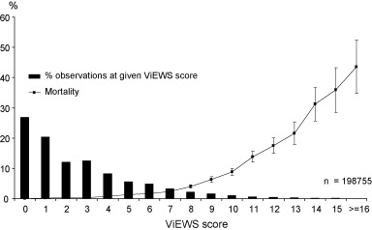
EARLY WARNING SCORE
Developed using vital signs from nearly 35,000 patients
Evaluated test performance for mortality
Performed better than other aggregate weight trigger systems
Resuscitation 2010; 81(8): 932-937

Slide 3
MEWS
Utah modified Early Warning Score (mEWS)
Measure | 3 | 2 | 1 | 0 | 1 | 2 | 3
Temperature |  | <35.0 | 35.1-35.5 | 35.6-38.0 | 38.1-39.0 | 39.1-40.9 | >41.0
Respiratory Rate | <8 |  | 9-11 | 12-20 | 21-25 | 26-29 | >30
Pulse | <30 | 31-39 |  | 40-100 | 101-110 | 111-130 | >131
Systolic BP | <80 | 81-90 | 91-100 | 101- 180 | 181-200 | 201-220 | >221

Slide 4
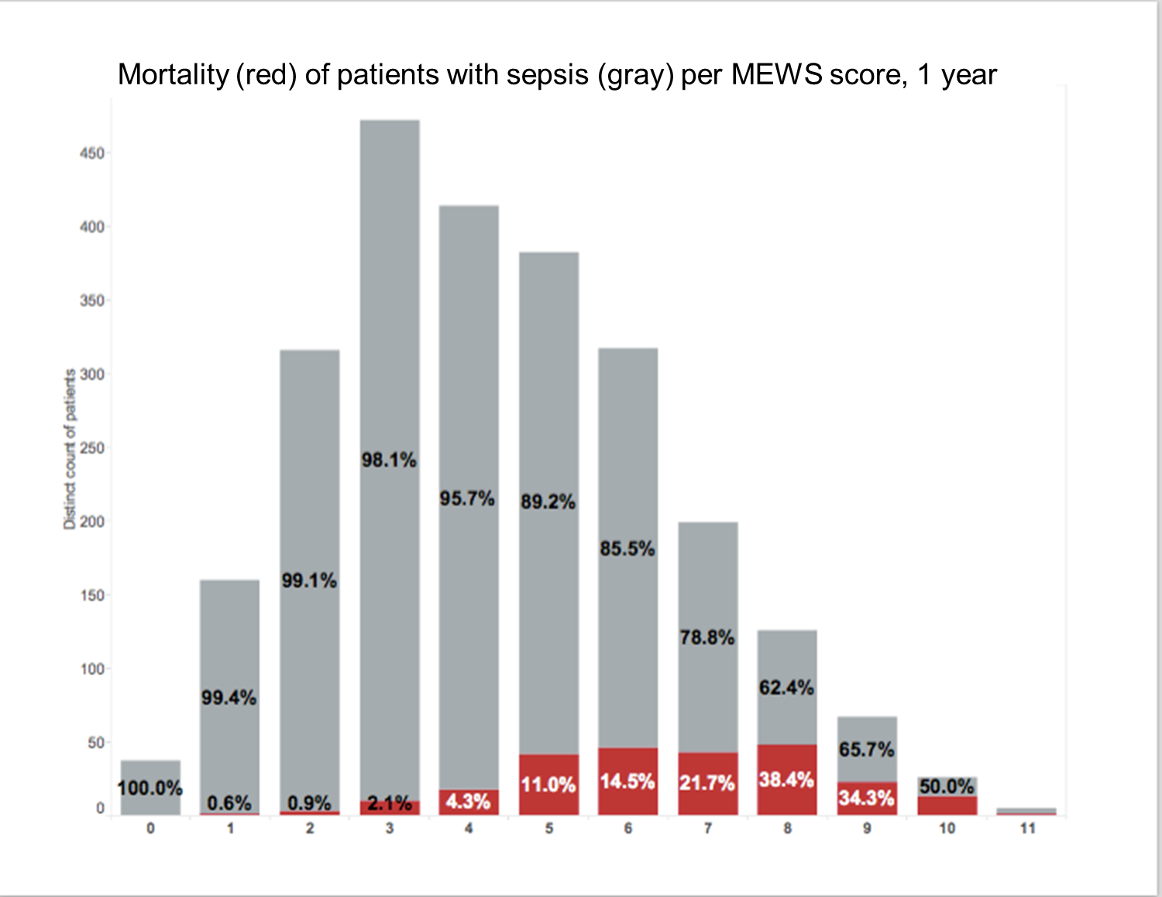

Slide 5
Questions?
Kencee.Graves@hsc.utah.edu
Devin.Horton@hsc.utah.edu

